Slide 1


Slide 2


Student Record Management System
Group members:
S.M. Hussain SM-06892
Razi Haider RH-06882
S.M. Daniyal Murtaza Zaidi SZ-06880
Course: Course Instructor:
DSA (CS 102-L4) Prof. Nadia Nasir

Slide 3
Project Description
The project which we are going to make is a type of learning management systems in which we will use a Tkinter for GUI.
In this SRMS (Student Record Management system), we have created random data of students and create Six Tabs of Course like (Pfun, DSA, CAl1) and every 2 Tabs would belong to each Year Batch like(freshmen, Sophomore, Senior) and each tab containing (Data of students, Grades, Test Marks, student progress etc).
We are using sorting algorithm for sorting the Test marks, grades or GPA and will use a Searching algorithm to find out the data of students and will use Matplotlib library for showing the progress of student by graphs so these are the funtions of our program.

Slide 4

Login Interface
Username
Password
Forgot Password
Verification

Slide 5
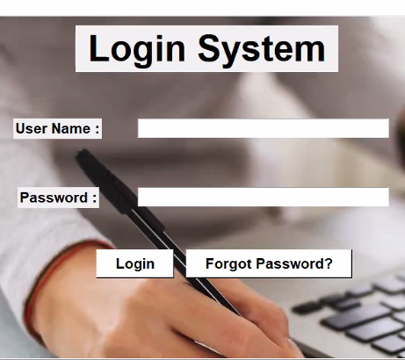
Login Interface
Our aspiration was to built a login system like that of famous social platform “Facebook”.
So, we had used labels:
Username
Password
And Buttons:
Login
Forgot Password

Slide 6
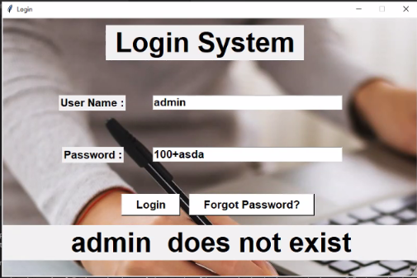
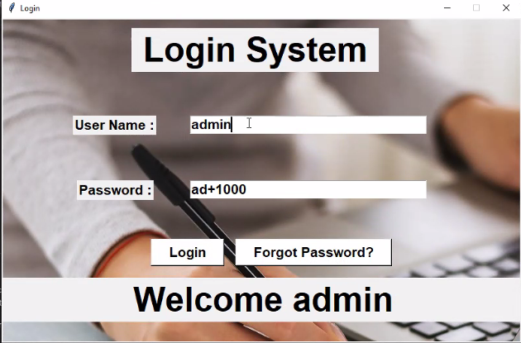
Login System
For Incorrect Password or Username.
For Correct Password and Correct Username.

Slide 7
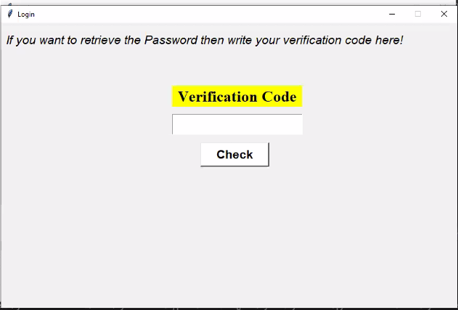
Verification Code
It is provided to the instructor.
If someone forget password. They should click on forgot password in the previous interface.
By clicking on it, this window will appear.

Slide 8
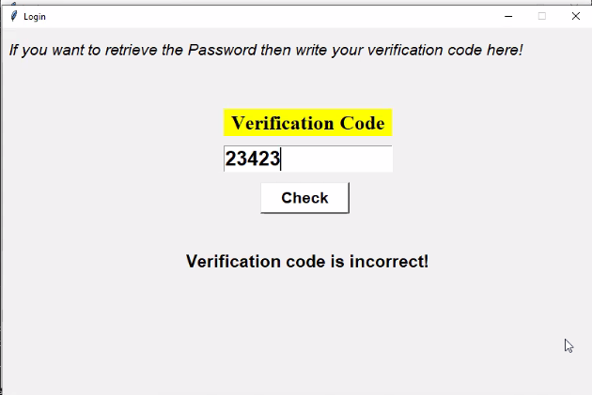
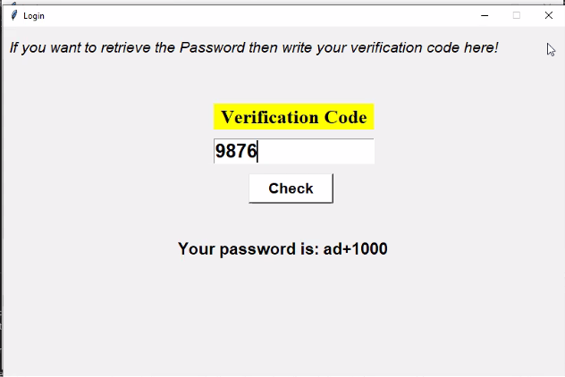
Verification Code
For Incorrect Verification Code
For correct Verification Code

Slide 9
Successfully Log-in
After receiving the approval message “WELCOME ADMIN”. you must close the login window to arrive at the main interface.

Slide 10
Main Interface Elements
Quick Search
Update Student Record
Registration form

Slide 11
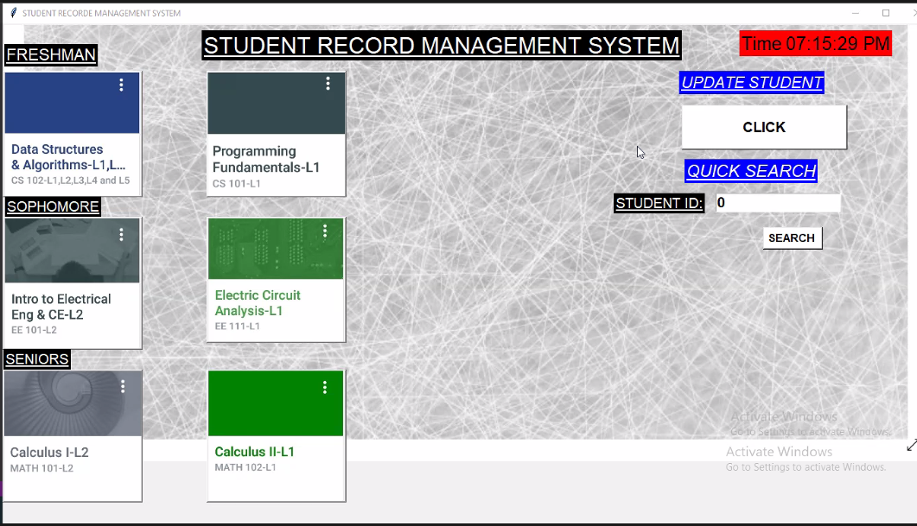
SRMS Main Interface

Slide 12
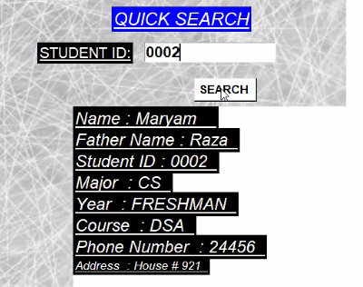
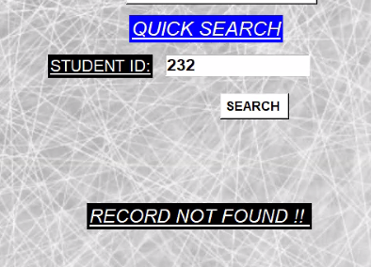
Quick Search “Interface for Searching Student’s Data”
For Enrolled ID
For Un-enrolled ID
Note: Before a new Search, the user need to enter 0 in student ID entry box for clearing the previous data.

Slide 13
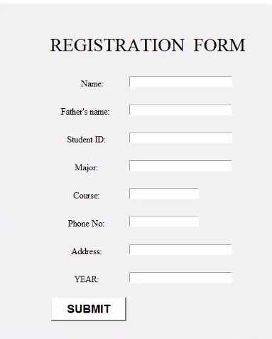
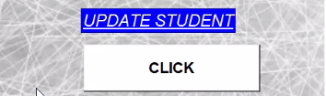
Update Student
“Interface for Updating Student Data”

Slide 14
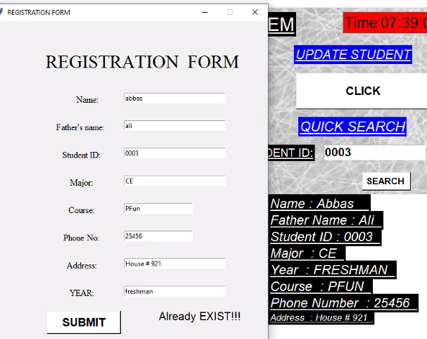
If
D
A
T
A
Already Exist?

Slide 15
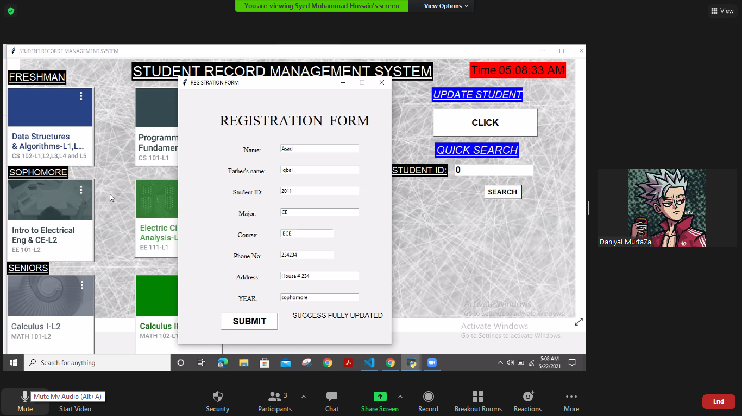
If
D
A
T
A
Is new?

Slide 16
Course Interface Elements
List of students
Grade list
Update Grades
Student Progress
Announcement Pad

Slide 17
Main Interface (Course)

Slide 18
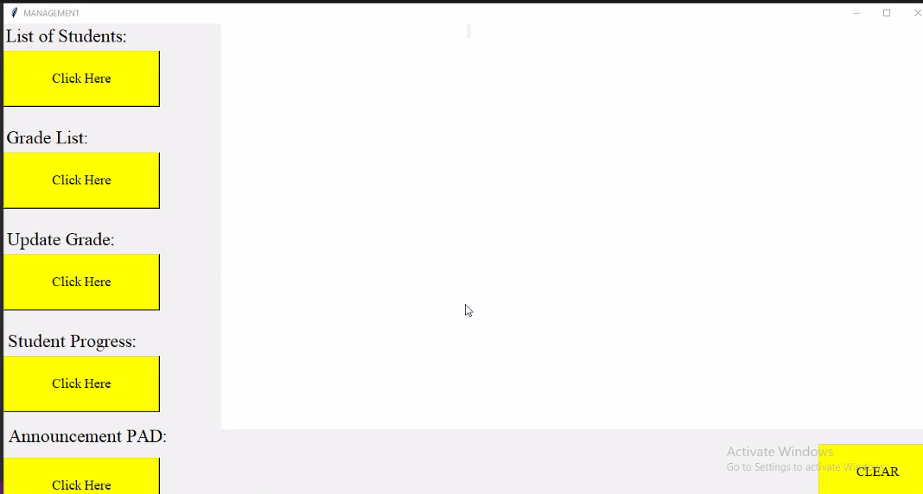
Course Interface

Slide 19
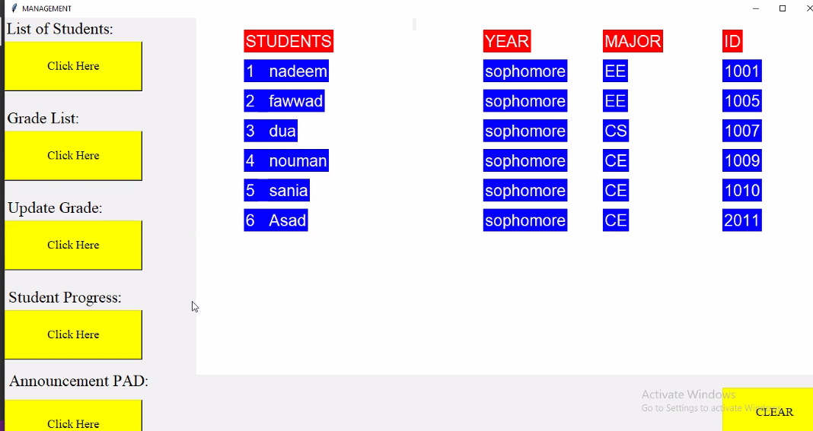
List Of Students

Slide 20
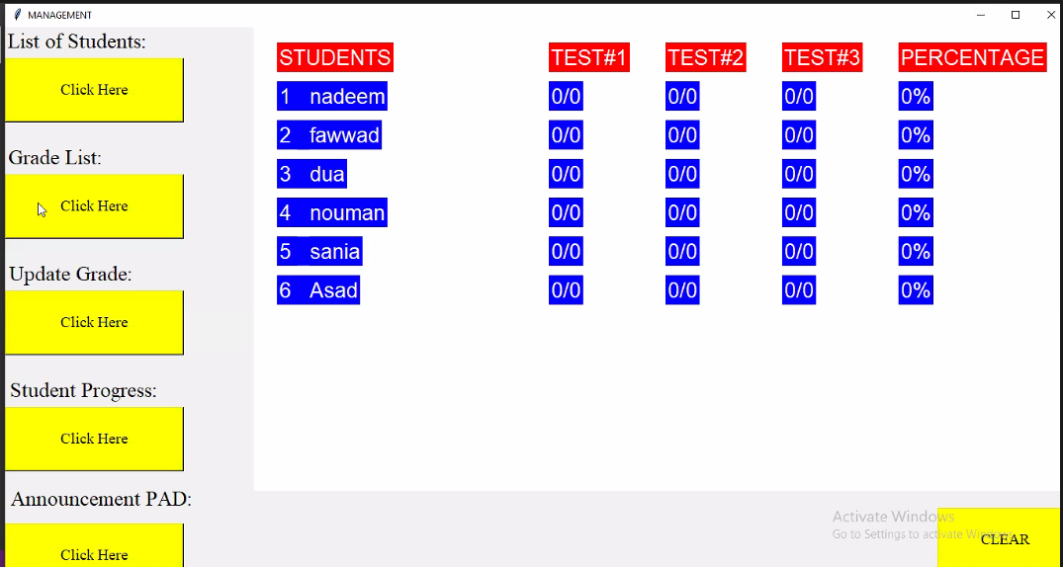
Grade list

Slide 21
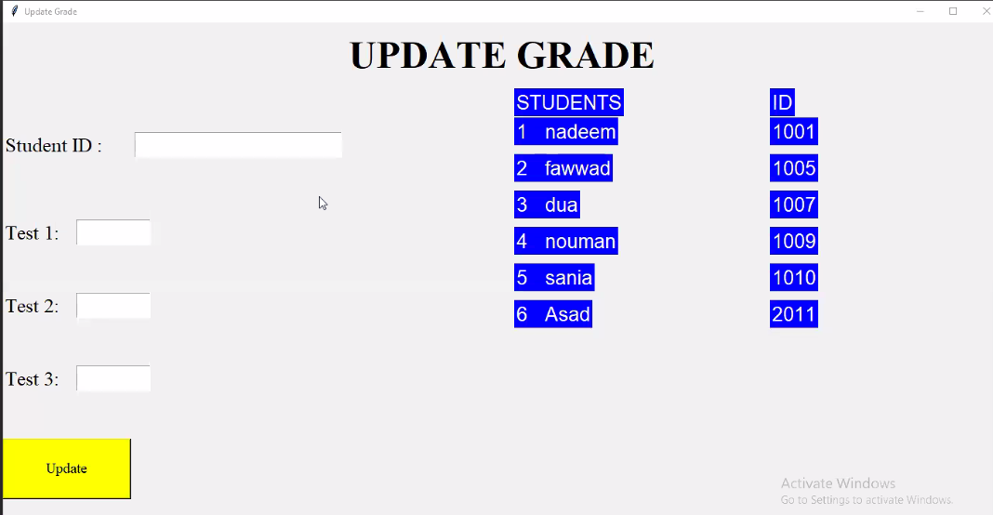

Slide 22
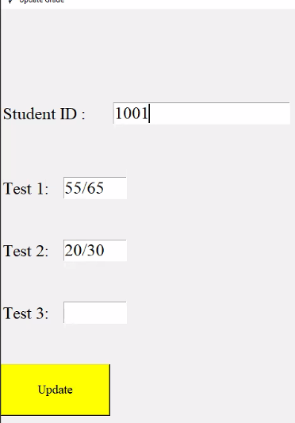
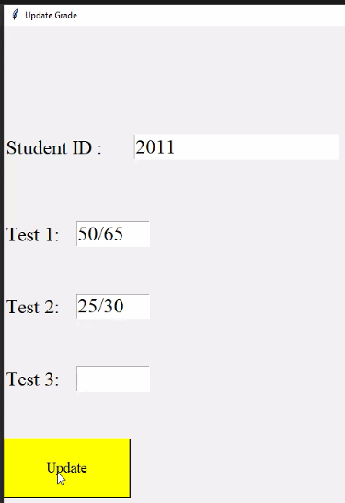
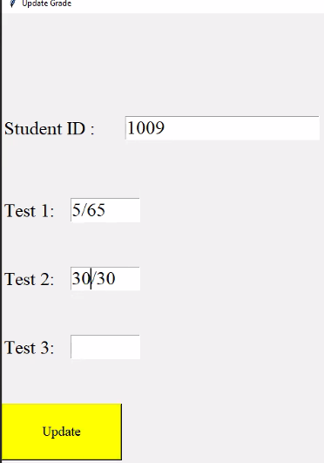
Updating Students Marks

Slide 23
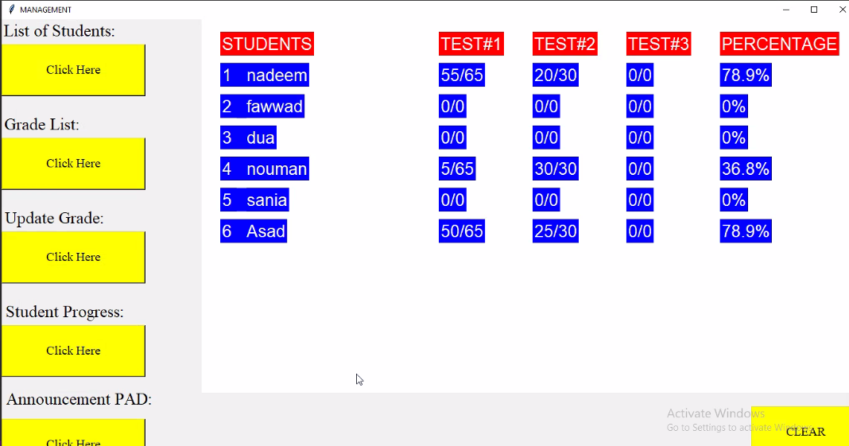
Grade List

Slide 24
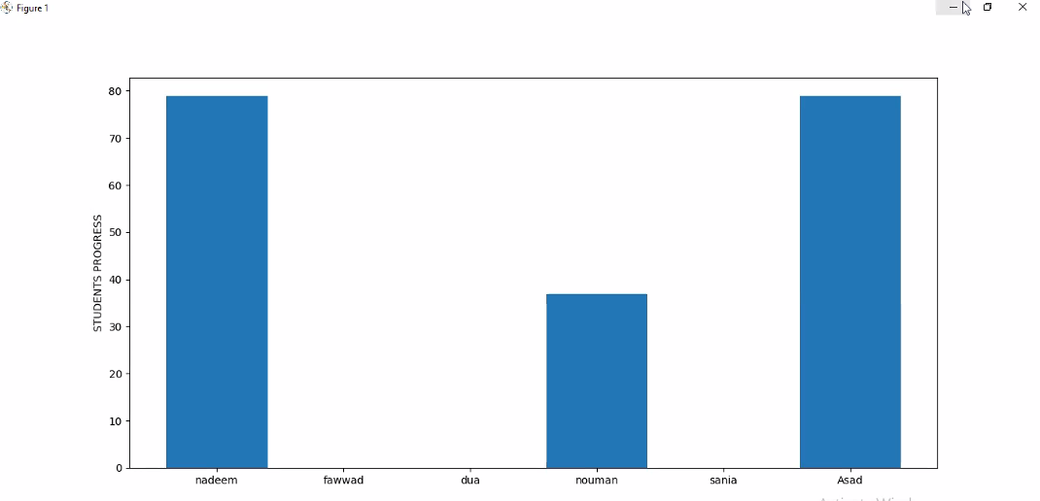
Student Progress

Slide 25
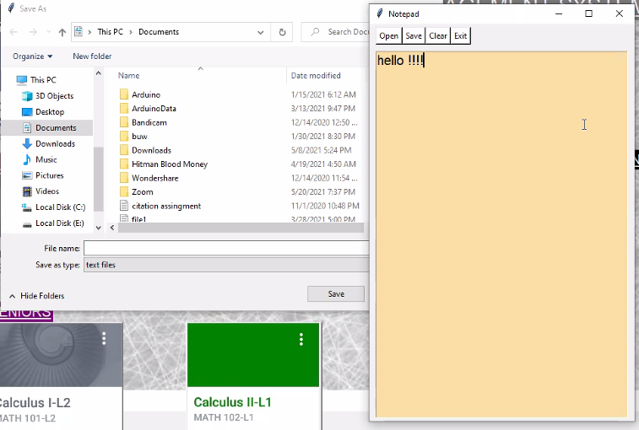
Announcement Pad

Slide 26
Project Outcomes
The project outcomes of our program are that the teacher or course instructor can insert the data or grades of a student and see the progress of the student by graph and get the results of the test in the form of sorted data and find the information of students and can generate the GPA of student.
Now we are shifting to Code (Backend work) and Code Demo!

Slide 27
Thank You!
DSA (CS 102 – L4)

